Slide 1

Integrating visual communication and storytelling in Software Engineering
Vaishnavi V

Slide 2


Disclaimer

Slide 3
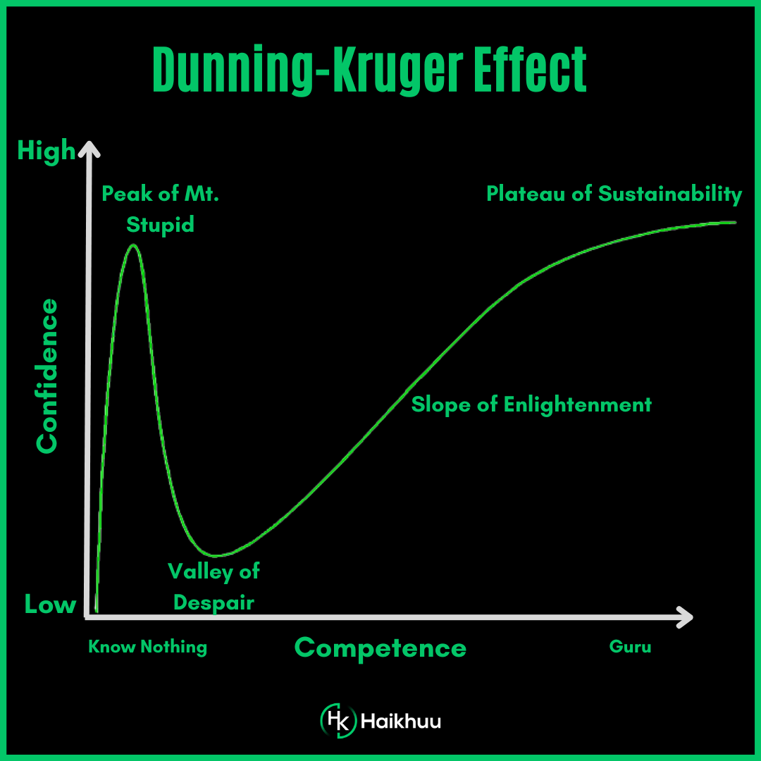
Dunning-Kruger effect

Slide 4
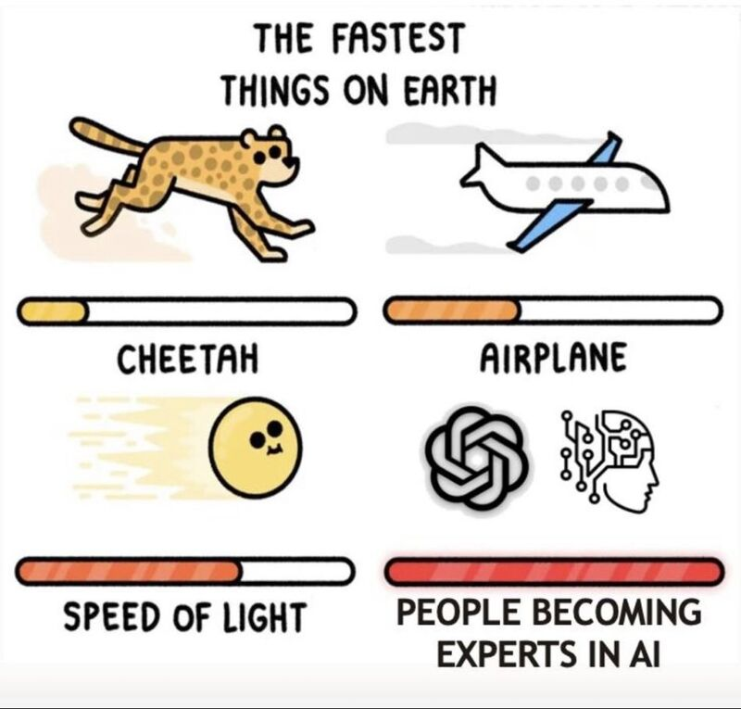
Not an expert!
Notes:
We're now witnessing the Dunning-Kruger effect in action and scale never seen before 😅
Remember - AI won't take your job but people who are "experts" in AI will 😉

Slide 5
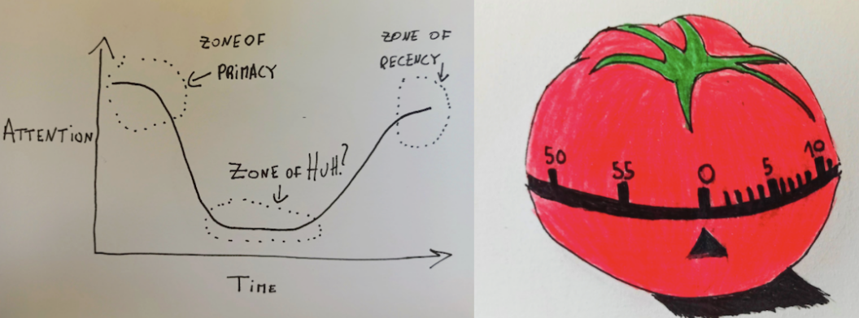
Attention Span
Source : https://semaphoreci.com/blog/storytelling-programming
Notes:
When we perform a task, like learning for an exam, our level of attention varies:
Zone of Primacy: our attention level is high (first 20 minutes)
Zone of Huh: our attention level is low (unlimited)
Zone of Recency: our attention level is high again (last 5 minutes)

Slide 6
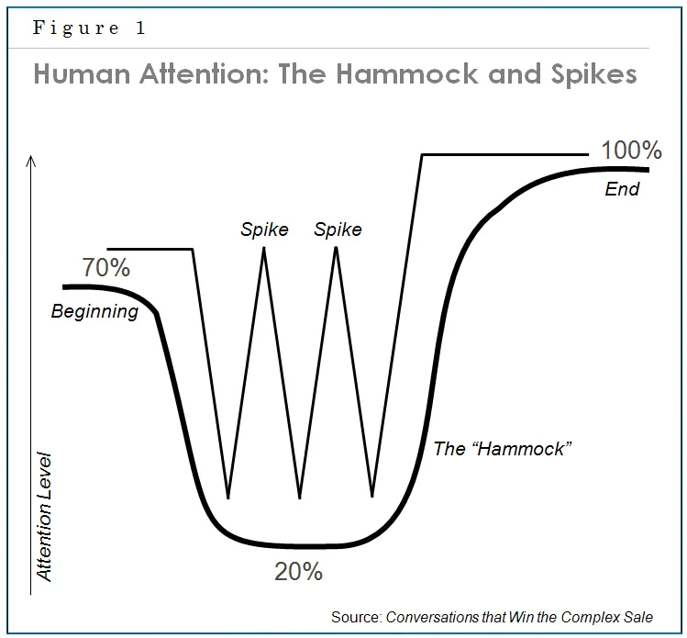
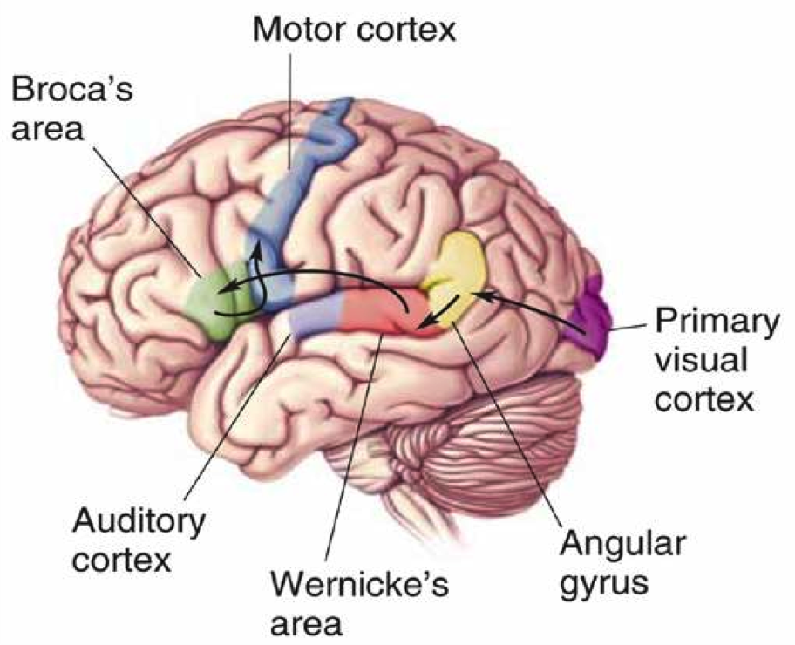
Human attention
Notes:
The part of the brain that processes visual information (the visual cortex) is much larger than the part of the brain responsible for reading words (the broca). By providing your information in a visual presentation, you make it much easier on your team to process the information effectively.
When we perform a task, like learning for an exam, our level of attention varies:
Zone of Primacy: our attention level is high (first 20 minutes)
Zone of Huh: our attention level is low (unlimited)
Zone of Recency: our attention level is high again (last 5 minutes)

Slide 7

Definition
Visual communication is the practice of using visual elements to get a message across, inspire change, or evoke an emotion.

Slide 8
Show, Don’t Tell
By telling, you simply inform the reader, presenting them with factual statements, while by showing, a more intimate connection is being created
Notes:
“Don’t tell me the moon is shining. Show me the glint of light on broken glass.”
― Anton Checkhov

Slide 9
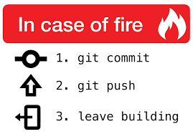
Tell, Don’t Ask
“Programs must be written for people to read, and only incidentally for machines to execute” (SICP)*
Structure and Interpretation of Computer Programs:
Notes:
“Don’t tell me the moon is shining. Show me the glint of light on broken glass.”
― Anton Checkhov

Slide 10
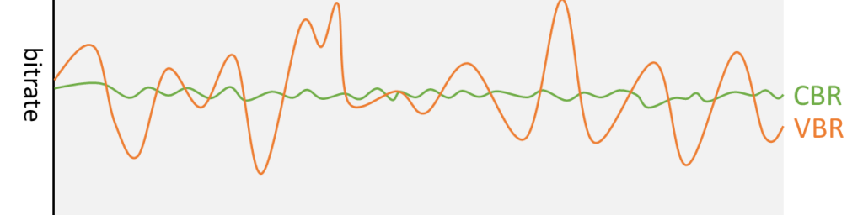

Slide 11
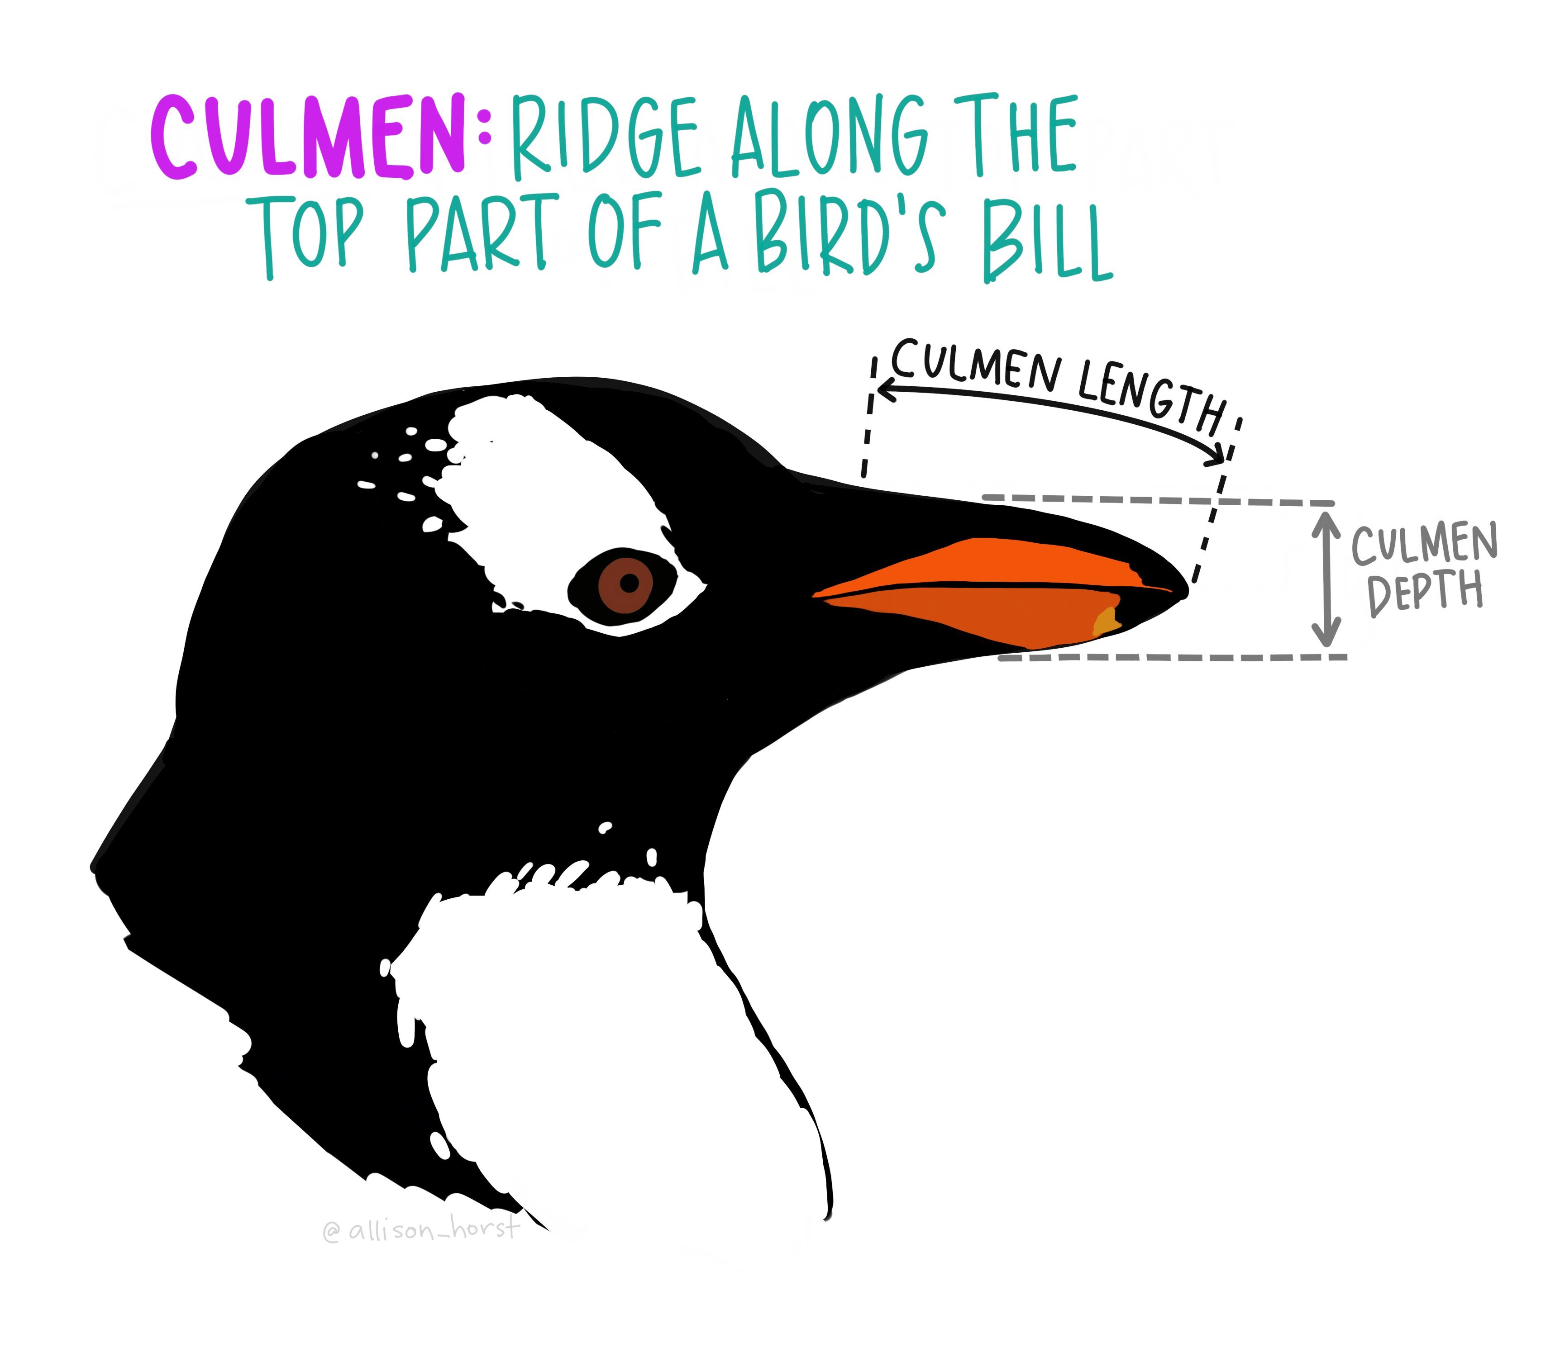
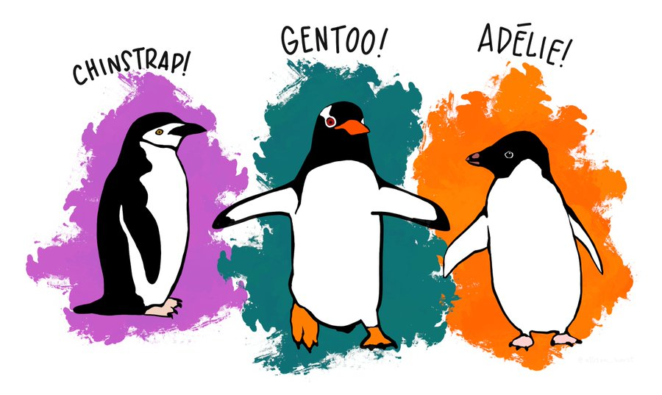
Penguin Dataset
Goal
Determine the species of a penguin
Parameters :
• Culmen length
• Culmen depth
• Flipper length
• Body mass
Source : Twitter

Slide 12
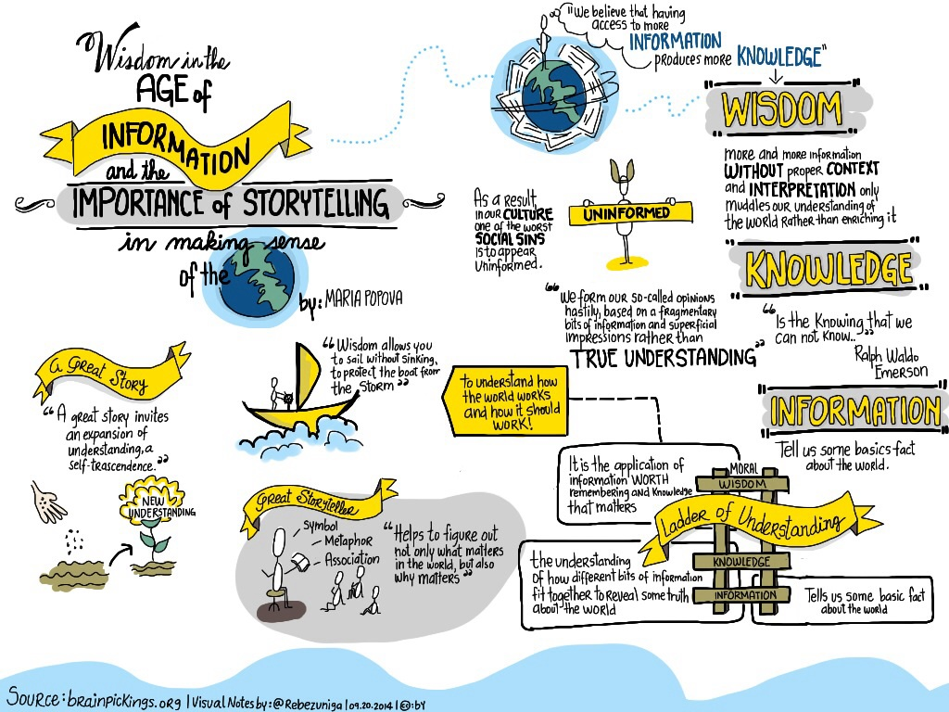

Slide 13
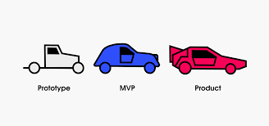
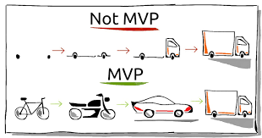
Perfect MVP
Communication design refers to crafting a message that educates, motivates, and engages the viewer.
Graphic design uses design principles to communicate that message in a way that is clear and eye-catching to the intended audience.

Slide 14
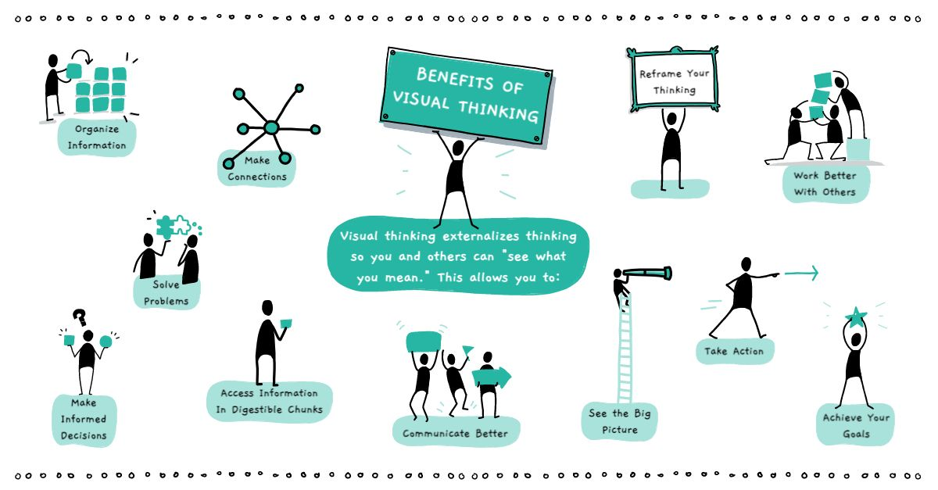
Definition
Visual communication is the practice of using visual elements to get a message across, inspire change, or evoke an emotion.
Source : Drawify

Slide 15
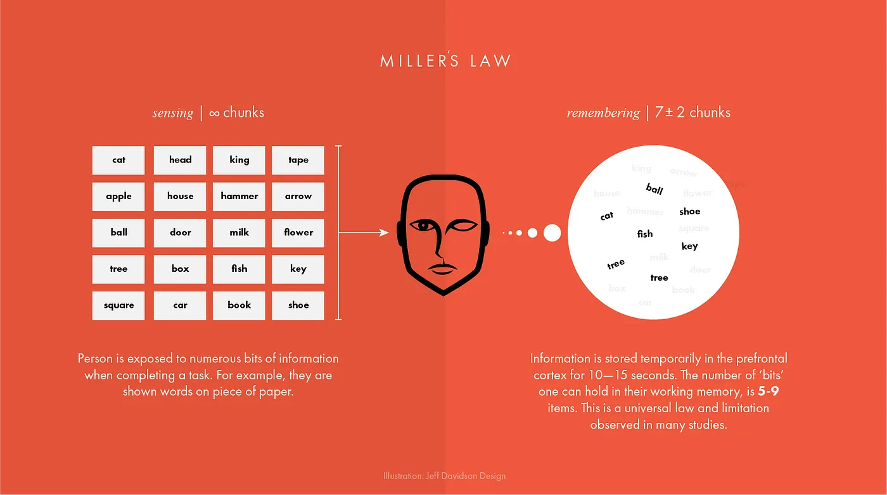
Working Memory – Information Processing
Unique
Tested
Showing the impact of your work by using data visualization
Telling stories through visuals and data
Elephant
Authentic
Creating more memorable information through the use of symbols and icons
Harnessing color to illustrate importance and attract attention
Notes:
The first concept is "chunking" and the capacity of short term memory. Miller (1956) presented the idea that short-term memory could only hold 5-9 chunks of information (seven plus or minus two) where a chunk is any meaningful unit. A chunk could refer to digits, words, chess positions, or people's faces. The concept of chunking and the limited capacity of short term memory became a basic element of all subsequent theories of memory.

Slide 16
George Miller’s Magical Number of Immediate Memory
Unique
Tested
Showing the impact of your work by using data visualization
Telling stories through visuals and data
Elephant
Authentic
Creating more memorable information through the use of symbols and icons
Harnessing color to illustrate importance and attract attention
Notes:
Humans are visually oriented animals with approximately 55% of our cortex is dedicated to processing visual stimuli.
The first concept is "chunking" and the capacity of short term memory. Miller (1956) presented the idea that short-term memory could only hold 5-9 chunks of information (seven plus or minus two) where a chunk is any meaningful unit. A chunk could refer to digits, words, chess positions, or people's faces. The concept of chunking and the limited capacity of short term memory became a basic element of all subsequent theories of memory.

Slide 17
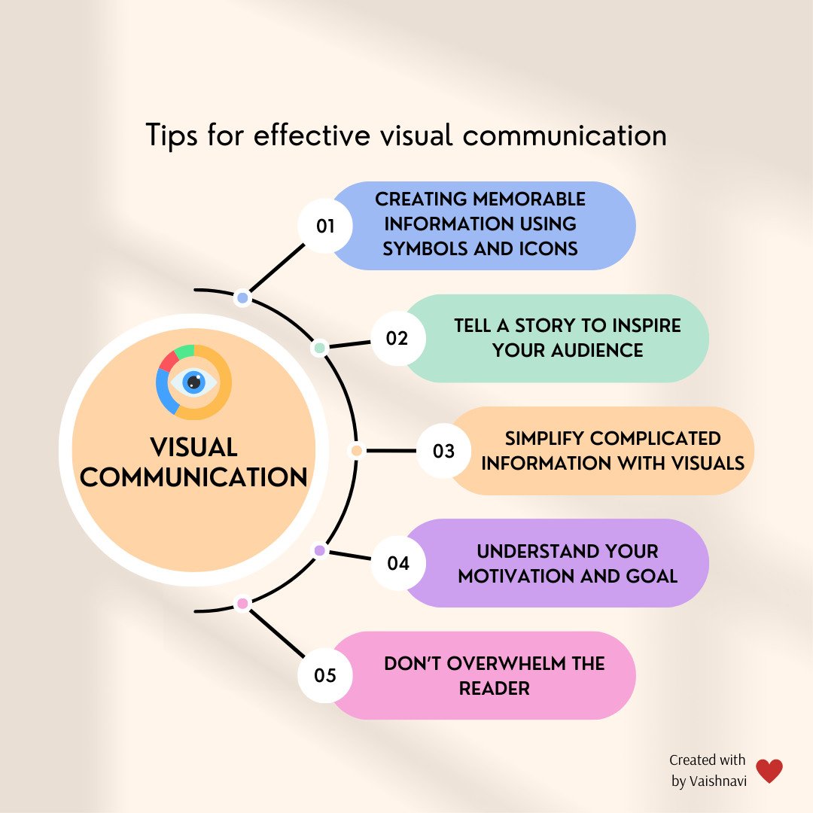
Notes:
The part of the brain that processes visual information (the visual cortex) is much larger than the part of the brain responsible for reading words (the broca). By providing your information in a visual presentation, you make it much easier on your team to process the information effectively.

Slide 18

Examples

Slide 19
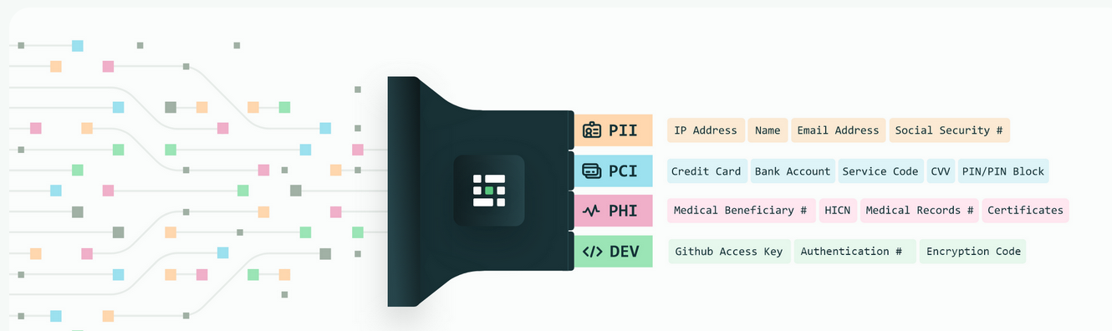
Privacy
Source : Medium blog
Notes:
Personal Identifiable Information (PII) is defined as: Any representation of information that permits the identity of an individual to whom the information applies to be reasonably inferred by either direct or indirect means.

Slide 20
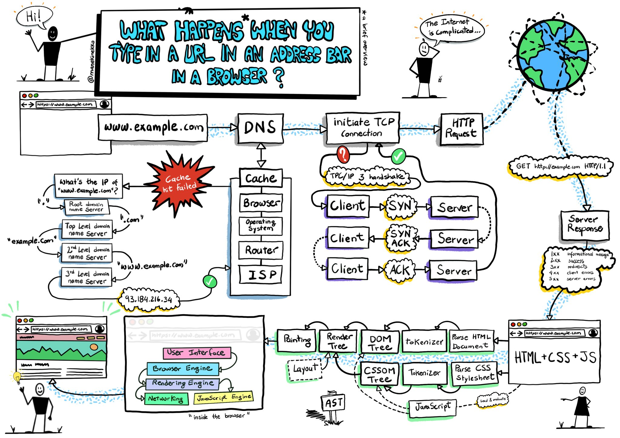
ELI5
Source :Wassim Chegham
Notes:
Personal Identifiable Information (PII) is defined as: Any representation of information that permits the identity of an individual to whom the information applies to be reasonably inferred by either direct or indirect means.

Slide 21
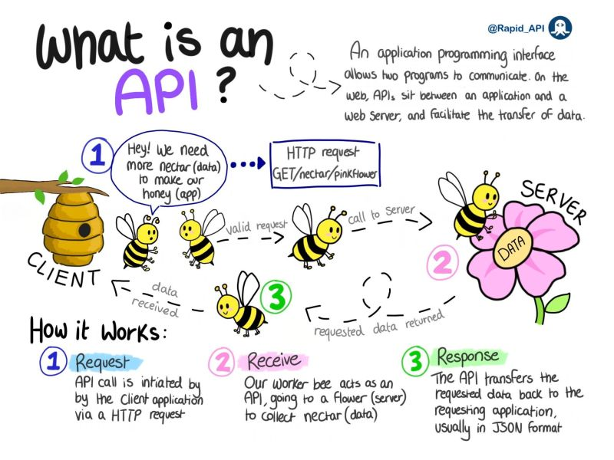
API
Source :
Notes:
Personal Identifiable Information (PII) is defined as: Any representation of information that permits the identity of an individual to whom the information applies to be reasonably inferred by either direct or indirect means.

Slide 22
Not this!

Slide 23

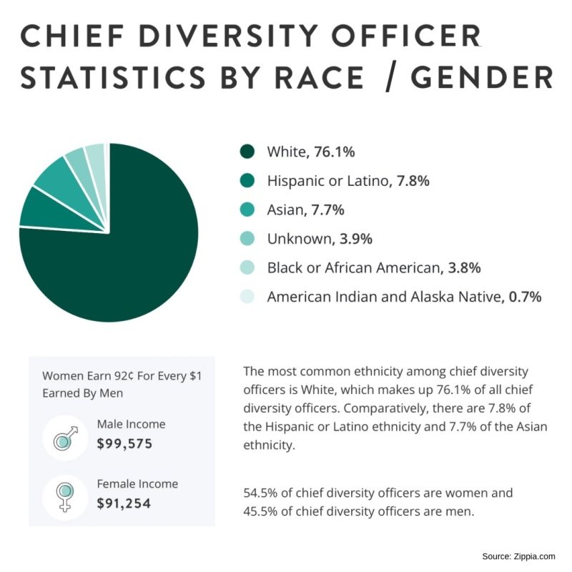
Don’t Overwhelm the user!

Slide 24
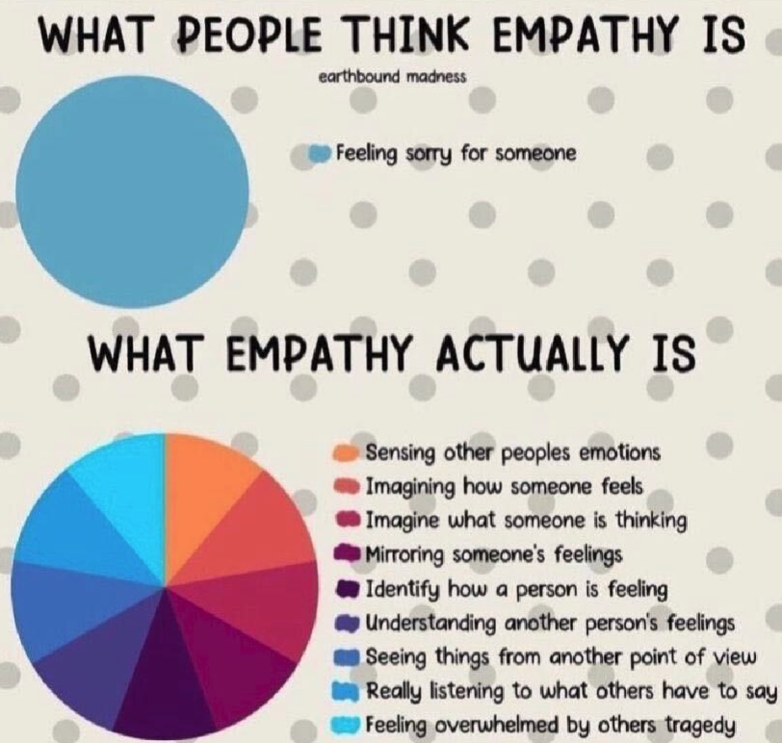
Colors?
Don’t Overwhelm the user!

Slide 25
Manual Of Me

Slide 26
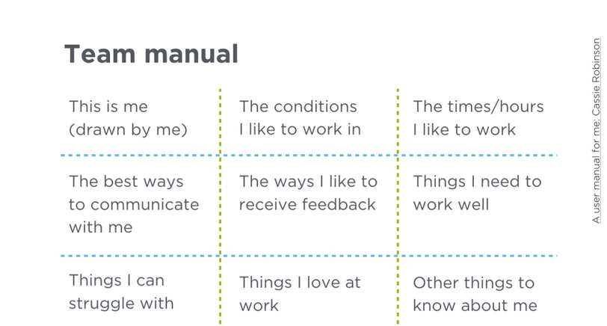

Slide 27


Slide 28
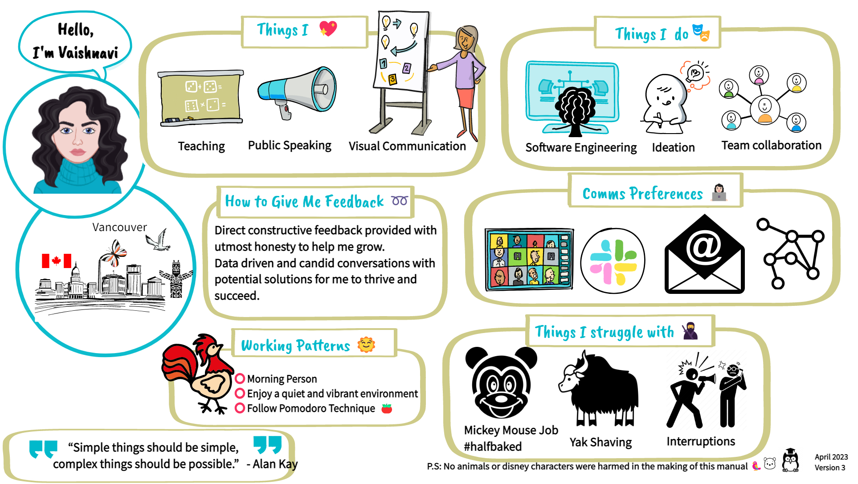

Slide 29
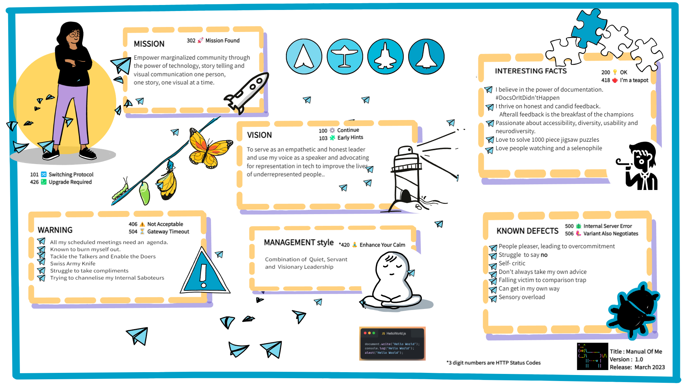
Meet the team

Slide 30
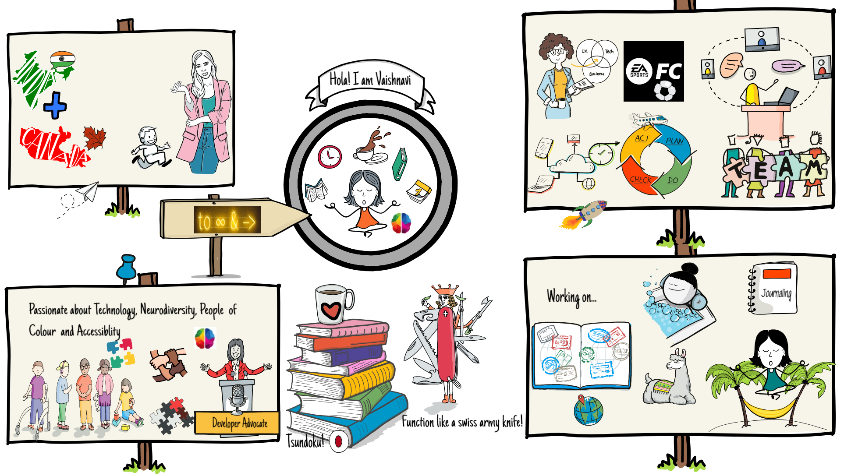
Meet the team

Slide 31
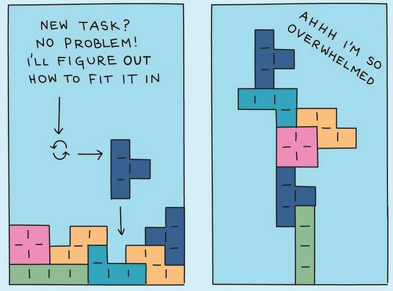
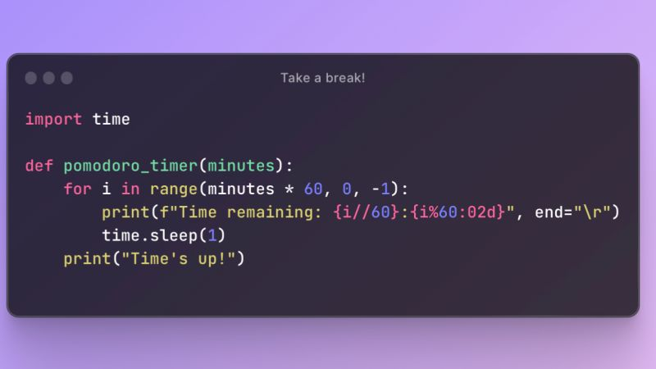

Ideas
$3B
$2B
$ 1B
Opportunity to build
Fully inclusive market
Total addressable market
Freedom to invent
Selectively inclusive market
Serviceable available market
Few competitors
Specifically targeted market
Serviceable obtainable market

Slide 32
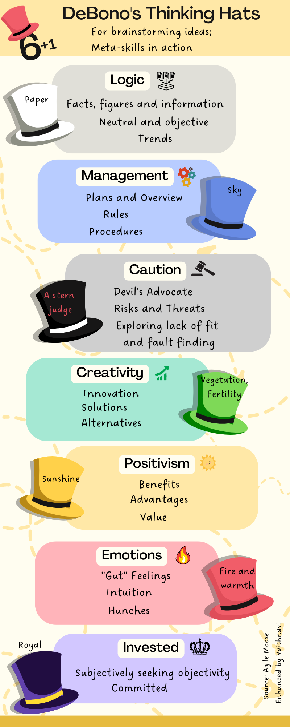

Slide 33
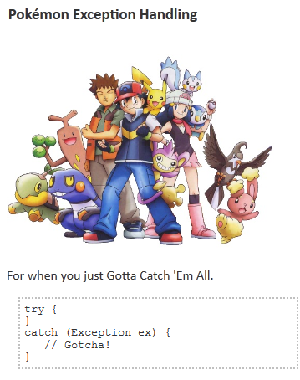

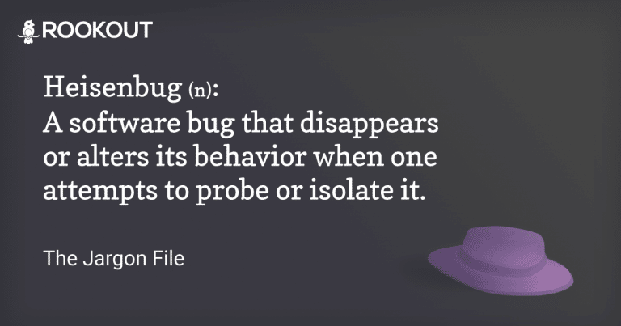

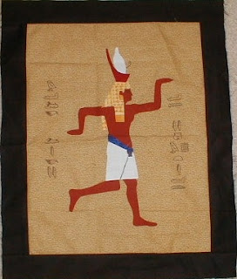
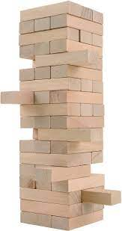
Programmer Jargon

Slide 34
The part of the brain that processes visual information (the visual cortex) is much larger than the part of the brain responsible for reading words (the broca). By providing your information in a visual presentation, you make it much easier on your team to process the information effectively.

Slide 35

Containerization (Optional)
Think of shipping containers on a boat.
A shipping container is like a Docker container.
A port is a facility that will load/unload, manage, move, inventory, and handle shipping and movement logistics. This is Kubernetes.
Containers are horses and Kubernetes is the Ranch managing those horses.
You decide how many horses in the ranch and the Ranch Manager will make sure to keep that many
horses there at all times. They can also bring other horses from other ranches if one dies to make sure they always have exact amount of horses you specified
Kubernetes automates a lot of the cloud set and forget stuff. How do you have redundancy’s. Tell kubernetes I want 3 of these boom you have three. What’s underneath? Maybe docker. Instead of you doing the scripting docker does it.
Opportunity to build
Fully inclusive market
Total addressable market

Slide 36
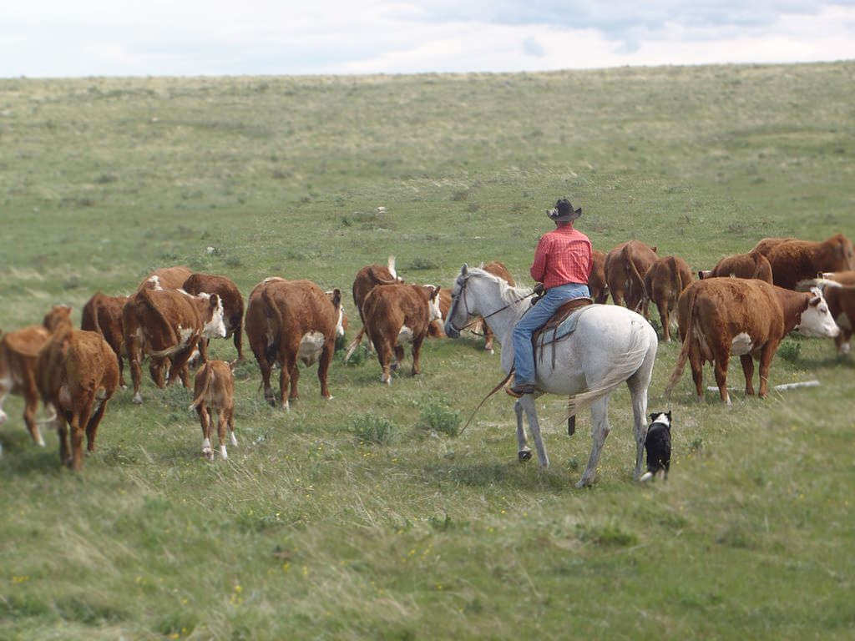
Notes:
Think of shipping containers on a boat.
A shipping container is like a Docker container.
A port is a facility that will load/unload, manage, move, inventory, and handle shipping and movement logistics. This is Kubernetes.
Containers are horses and Kubernetes is the Ranch managing those horses.
You decide how many horses in the ranch and the Ranch Manager will make sure to keep that many
horses there at all times. They can also bring other horses from other ranches if one dies to make sure they always have exact amount of horses you specified
Kubernetes automates a lot of the cloud set and forget stuff. How do you have redundancy’s. Tell kubernetes I want 3 of these boom you have three. What’s underneath? Maybe docker. Instead of you doing the scripting

Slide 37

What next?
Convergence
In today's digital world, AI, cloud computing, the internet of things (IoT), and superfast networks such as 5G are the cornerstones, and data is the fuel that drives them all. These technologies are some of the data science latest trends. Together, these technologies enable much more than they can do separately.

Slide 38
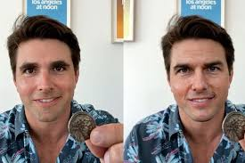
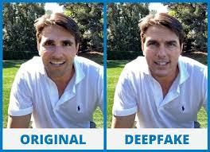
DEEPFAKE TECHNOLOGY: SEEING IS BELIEVING, OR IS IT?
Notes:
fabricate images and videos to the point where you won’t be able to tell what’s real and what’s not.

Slide 39
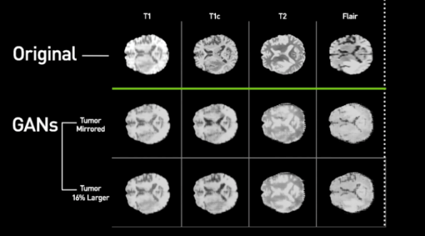
Deepfakes, Generative AI, and Synthetic data
Synthetic faces of people who have never existed can be created to train facial recognition algorithms while avoiding the privacy concerns involved with using real people’s faces.
It can be created to train image recognition systems to spot signs of very rare and infrequently photographed cancers in medical images because of lack of data due to privacy reasons, financial constraints, and rare diseases with few examples and little data to pull from.
To create language-to-image capabilities, allowing, for example, an architect to produce concept images of a building simply by describing how it will look in words.

Slide 40

Deepfakes, generative AI, and synthetic data
Synthetic voices have been used to help patients with ALS (Amyotrophic Lateral Sclerosis) who, due to the disease, often lose some or all of their ability to speak. With the use of this technology, they can speak with their loved ones with a voice that sounds just like theirs.
For educational purposes, deepfakes can be used to imitate teachers or bring back historical figures.
In film, the accessible nature of deepfakes means that independent creators without huge budgets can create their art.
Online shoppers trying on clothes in virtual fitting rooms, for dynamic museum dioramas and for actors hoping to speak multiple languages in international movie releases.

Slide 41
Deepfakes, Generative AI, and synthetic data – Word of Caution
Double Edged sword
Deepfakes are often weaponized against women. The majority of deepfakes on the internet are pornographic, in which female celebrities' faces are infused into these videos.

Slide 42



Slide 43


Thank you

